Slide 1
HTML
BLOCK A: Tips and Tricks
A collection of very simple tricks for beginners.

Slide 2
Color Picker
Color Picker (colorpicker.com) Just a normal color picker.
ColourLovers (http://www.colourlovers.com/) For better schemes and palettes.
Wondering where to get color codes? These are some pretty good tools.

Slide 3
Good Fonts
https://fonts.google.com/
Select font, copy and paste the "embed font" link in your webpage head.
Specify the font in your CSS.
For design inspiration and pairings:
https://www.typewolf.com/
http://fontpair.co/
http://fonts.greatsimple.io/
Google Fonts has a fantastic collection of font resources that are ready for the web.

Slide 4
Picture Fonts
FontAwesome (http://fontawesome.io/)
Provides a ton of amazing fonts for free, CDN available
Fontello (http://fontello.com/)
Generator with fonts to choose from
Linear Icons (https://linearicons.com/free)
Limited free collection, but easy to set-up
Need icons? These are easy to embed too. One addition to your header for thousands of pictures.

Slide 5
Transition Abuse
CSS3Generator (http://css3generator.com/)
CSS Transitions (http://css3.bradshawenterprises.com/transitions/) A good introductory tutorial and guide.
When you can, utilize CSS transitions to amp up your design.
Even a simple color transition upon link hover is an unexpected surprise.

Slide 6
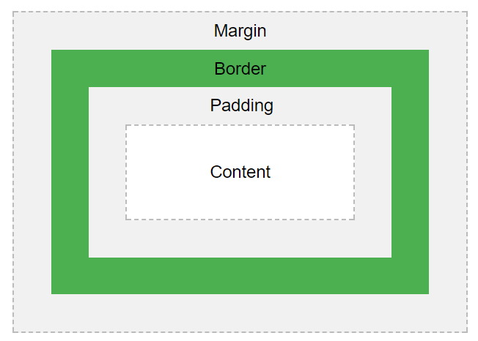
CSS Box Model
Content - The content of the box, where text and images appear
Padding - Clears an area around the content. The padding is transparent
Border - A border that goes around the padding and content
Margin - Clears an area outside the border. The margin is transparent
Confused about padding, margins, and everything else? It's important to know the hierarchy of these properties – also known as the "CSS Box Model."

